Slide 1
“Digital Image Processing using Filters in MATLAB ”
Mini Project - II
By:
Lokesh Y 1NH18EC061
Madala Bhanu Prakash 1NH18EC064
M Suchith 1NH18EC063
Santhosh Gowda M 1NH18EC102
Guided By
Mrs.Monika Gupta
Senior Assistant Professor
Dept. of ECE
New Horizon College of Engineering, Bengaluru

Slide 2
Contents
Introduction
Literature Review
Existing System
Problem Statement & Objectives
Block Diagram
Software Specification
Working
Algorithm & Flowchart
Results & Discussion
Advantages
Conclusion & Future Scope
References
Progress Work
Milestones/Schedule

Slide 3
Introduction
Digital image processing is the use of computer algorithms to create, process, communicate, and display digital images.
Digital image processing algorithms can be used to:
Convert signals from an image sensor into digital images.
Improve clarity, and remove noise and other artifacts.
Extract the size, scale, or number of objects in a scene.
Digital image processing has many advantages over analog image processing.
It allows a much wider range of algorithms to be applied to the input data and can avoid problems such as the build-up of noise and distortion during processing.

Slide 4
Filtering
Filtering is a technique used for modifying or enhancing an image like highlight certain features or remove other features.
Image filtering include Smoothing of image, Sharpening of image, Edge enhancement of image.
The filters used in the project are:
Mean filter
Median filter
Adaptive median filter

Slide 5
The parameters used to compare the results of the different Filtering techniques are:
Peak Signal-to-noise ratio (PSNR)
Mean Square Error (MSE)

Slide 6
Literature Review
Title of the paper | Author & Year of Publication | Outcome | Limitation
Comparative Analysis of image filtering techniques | J Singh (2015) | various image processing techniques have been discussed n explained | Time consuming
Application of matlab image processing technology | H Cao (2009) | easy understanding of need and application of matlab features in image processing | Lack of qualified professional
Image enhancement using filtering techniques | Krishna Kant Albania (2012) | image enhancement techniques to improve the image quality has been understood | A bit complicated

Slide 7
Existing System
Existing Systems:
The project deals with the filtering of the image there already exists many applications and software in market which will perform filtering action to an image and give good results.
Some of the software are paid, and some are free, some example of these software and applications are Adobe Photoshop, Snapseed, PicsArt Photo Studio, etc.

Slide 8
Problem Statement & Objectives
Problem Statement:
To read an image and use different filtering techniques to get a clear image and compare the PSNR and MSE values for different filters.
Objectives:
To get a clear image without any noise
Comparing the PSNR and MSE values for different filters
Finding out which Filtering method gives much favorable results

Slide 9
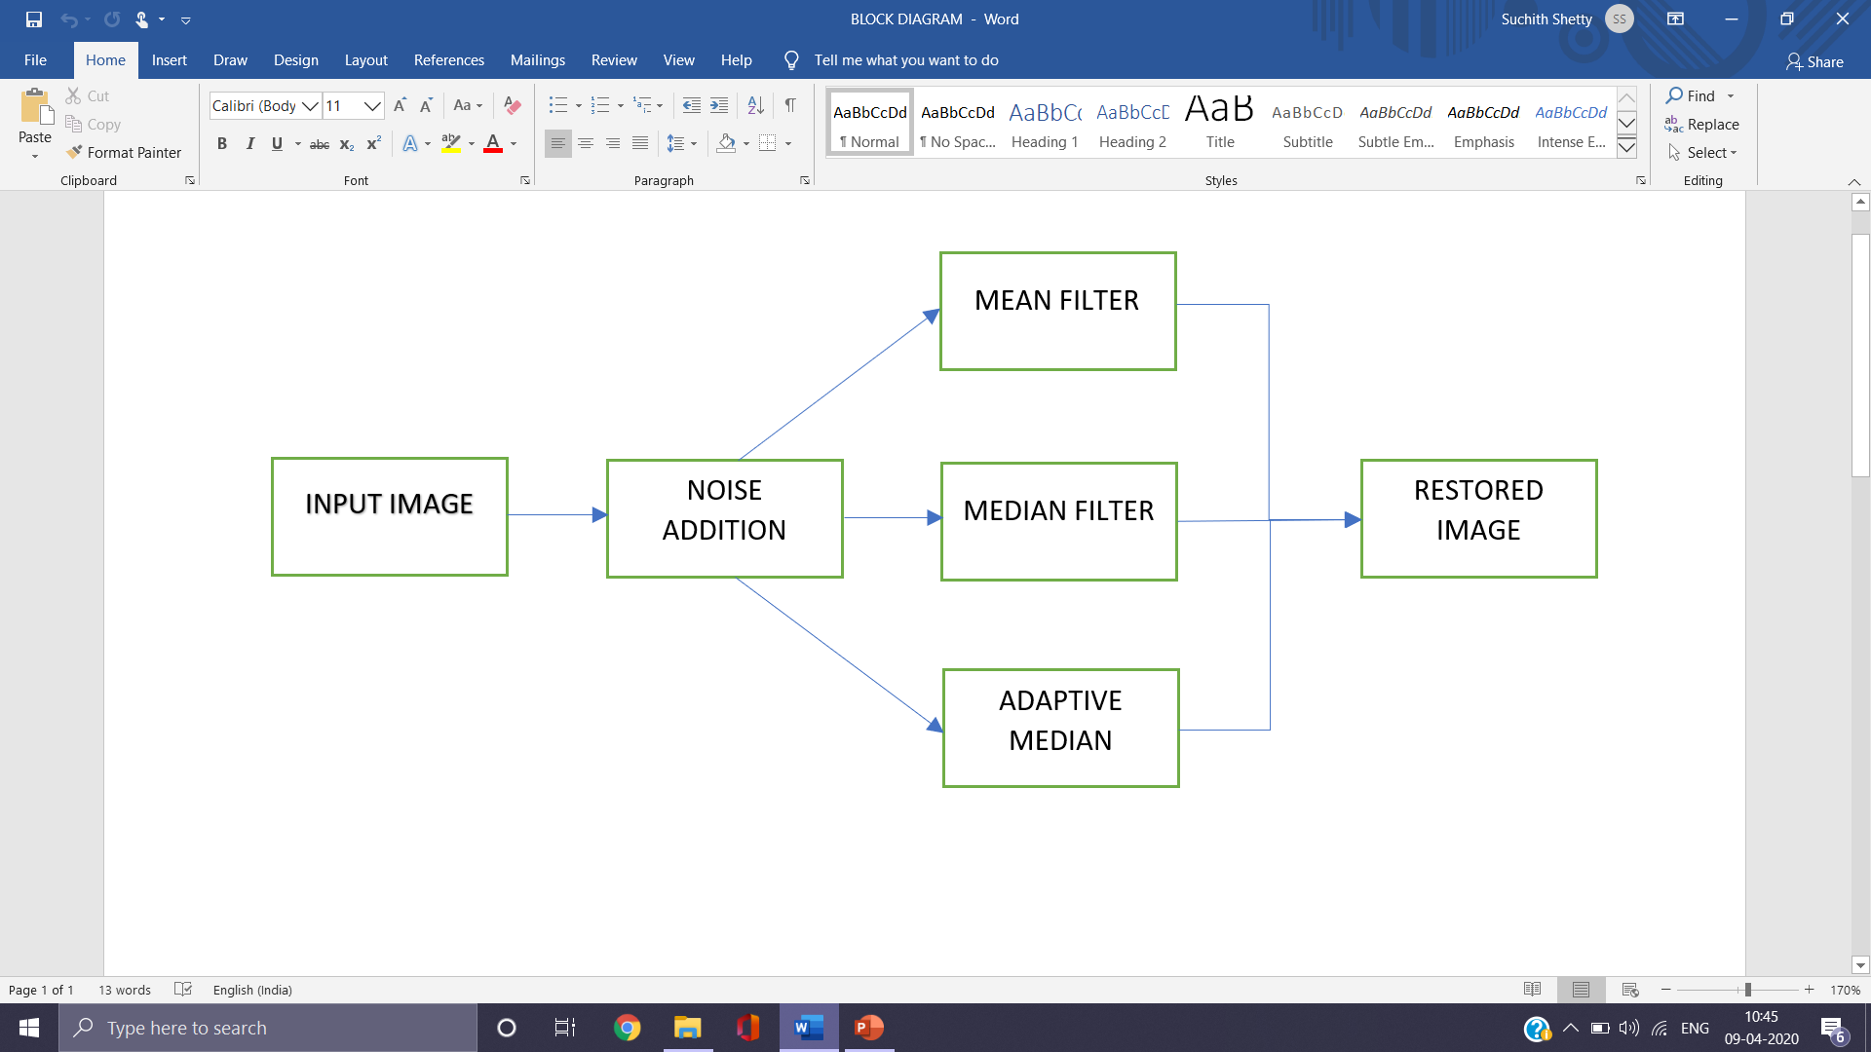
Block Diagram
Basic Block Diagram of Image filtering

Slide 10
Software Specification
MATLAB (matrix laboratory) is a multi-paradigm numerical computing environment and proprietary programming language developed by MathWorks.
It allows matrix manipulations, plotting of functions and data, implementation of algorithms, creation of user interfaces, and interfacing with programs written in other languages.
Although MATLAB is intended primarily for numerical computing Simulink, adds graphical multi-domain simulation and model-based design for dynamic and embedded systems.
DESIGNED BY: Cleve Barry Moler is an American mathematician and computer programmer specializing in numerical analysis.
DEVELOPER : Mathworks
SOFTWARE VERSION USED : Matlab 16.0

Slide 11
Working
Working concept
Initially first the code is written to read the image using inbuilt library function (‘imread’).Then the percentage of noise (salt and pepper) is added to the signal using another inbuilt library function(‘imnoise’).
After ploting the above two images the filtering action is performed.
In this project we have analysed or processed the noised image using three filters namely:
MEAN FILTER
MEDIAN FILTER
ADAPTIVE MEDIAN FILTER

Slide 12
After the filtering actions are done, for each filtered image PSNR and MSE is found and the images are analysed.
We are displaying the PSNR and MSE values on the command window.

Slide 13
Algorithm
Algorithm Used in Adaptive Median filter:
Step 1: Set window size, ws=3, wsmax=21
Step 2: m,n- row and column index of the noised image.
Step 3: Read neighboring pixel values w.r.t m,n and ws.
Step 4: Find S1, S2, and S3.
Where S1=min(neighboring pixel)
S2=median(neighboring pixel)
S3=max(neighboring pixel)
Step 5: A1 = S2 - S1
A2 = S2 - S3
If A1 > 0 and A2 < 0, Go to Step 6
Else increase the window size by 2
If window size <= wsmax repeat Step 5
Else output S2
Step 6: B1 = pixel(m,n) - S1
B2 = pixel(m,n) - S3
If B1 > 0 and B2 < 0, output pixel(m,n)
Else output S2

Slide 14
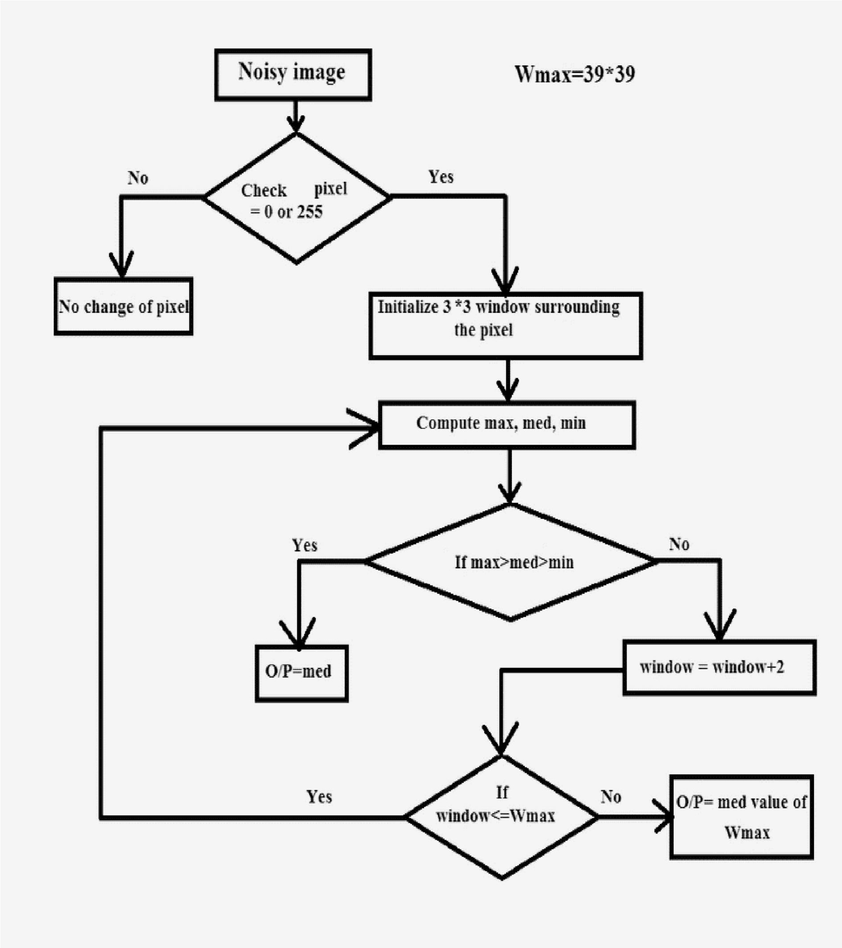
Flow Chart
Flowchart of Adaptive Median Filter

Slide 15
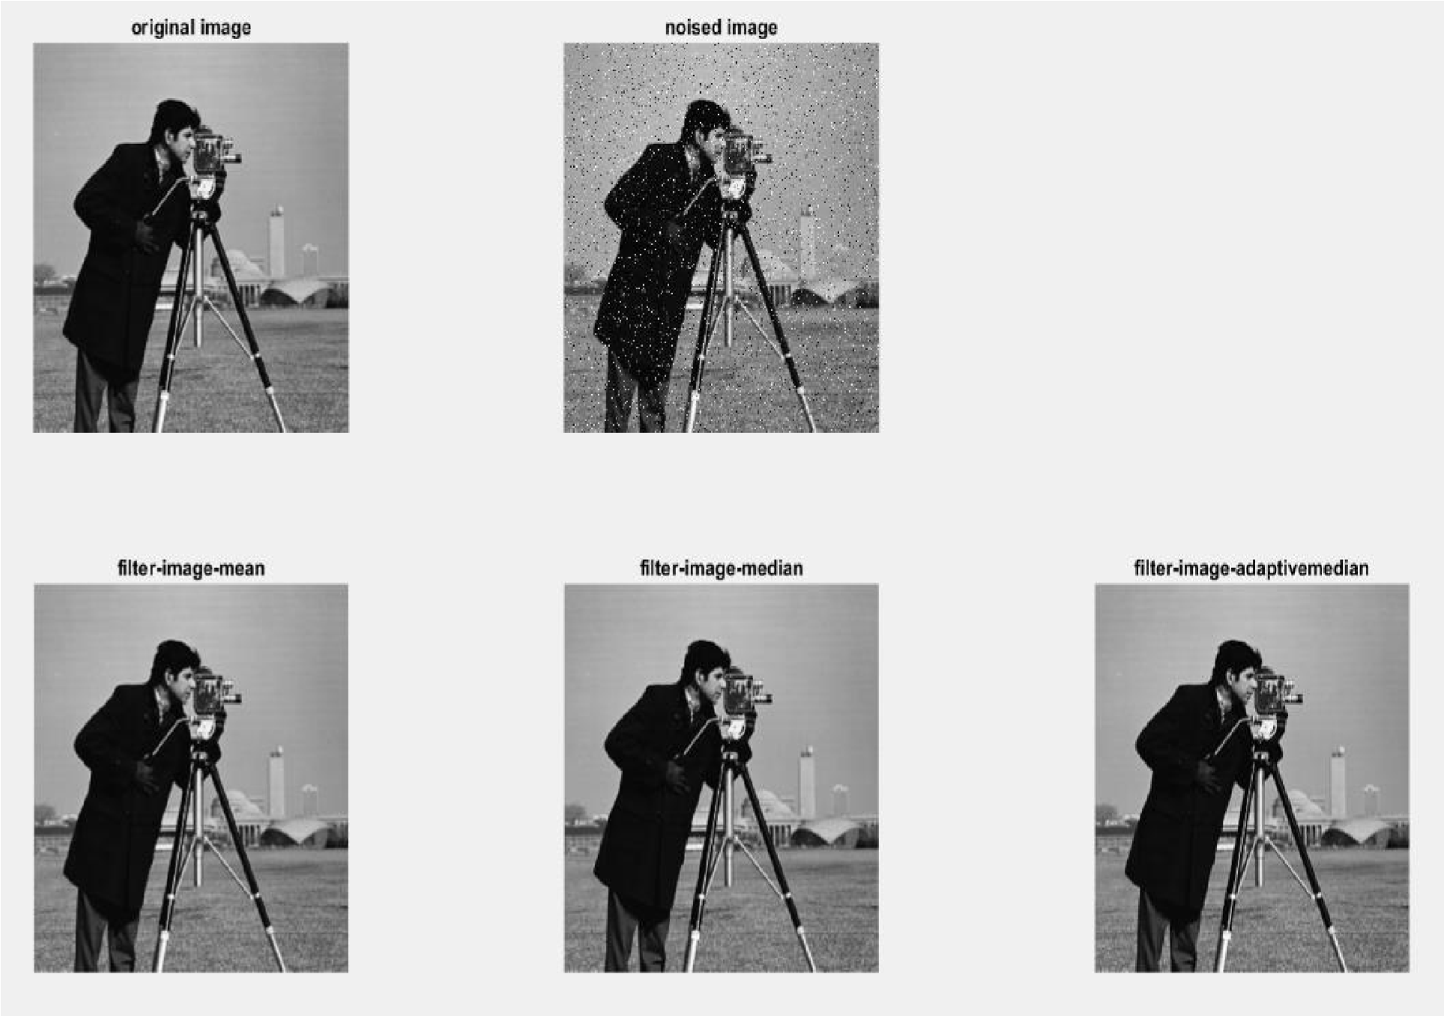
Results & Discussion
The Software Project, Digital Image Processing using Filters is working perfectly as per our objectives. It takes image input and filtering action is done on the noised image and Filtered output is show on figure window.

Slide 16
For 5% Salt and Pepper noise
SL.NO | Name of the Filter | PSNR | MSE
1 | Mean Filter | 45.2712 | 1.9318
2 | Median Filter | 48.1856 | 0.9875
3 | Adaptive Median Filter | 54.3200 | 0.2405
For 10% Salt and Pepper noise
SL.NO | Name of the Filter | PSNR | MSE
1 | Mean Filter | 45.2712 | 1.9318
2 | Median Filter | 46.3185 | 1.5179
3 | Adaptive Median Filter | 51.7501 | 0.4346
For 20% Salt and Pepper noise
SL.NO | Name of the Filter | PSNR | MSE
1 | Mean Filter | 45.2712 | 1.9318
2 | Median Filter | 43.2428 | 3.0818
3 | Adaptive Median Filter | 47.6034 | 1.1291

Slide 17
Advantages
Advantage of Adaptive Median Filter:
Remove impulse noise.
Smoothing of other noise.
Reduce distortion, like excessive thinning or thickening of object boundaries.
The standard median filter does not perform well when impulse noise is
a. Greater than 0.2, while the adaptive median filter can better handle these noises.
b. The adaptive median filter preserves detail and smooth non-impulsive noise, while the standard median filter does not.

Slide 18
Conclusion
When the Filtered Image has high PSNR value and low MSE value w.r.t a Noised image, than that image is better in details, least noise in it. Seeing the results of our project the PSNR and MSE values for Mean Filter do not vary with increase or decrease in noise content of the image.
The Median Filter performs well only till certain noise content, once the noise content is increased it will have poor filtering effect on the image, where as the Adaptive Median Filter will work very well in maintaining the details of the image and removing the noise, even when the noise content is high.
So we can conclude that the Adaptive Median Filter among the other two filters works very well, it is one of the best Filtering techniques that can be implemented in Image restoration.

Slide 19
Future Scope
To overcome the disadvantages and looking for implementing it into a proper software Application.
To implement this software into the hardware components like digital image sensors and make the image quality much better.
To implement this project on colored images as well.
To implement this and use in some mobile application to add some filtered effect to the image.

Slide 20
References
[1] Lim, Jae S., ”Two-Dimensional Signal and Image Processing”, Englewood Cliffs, NJ, Prentice Hall, 1990, pp. 469-476.
[2] Kenneth R. Castleman, ”Digital Image Processing”,
Prentice-Hall, 1996. ISBN 0-13-211467-4
[3] A. Marion, ”An Introduction to Image Processing”, Chapman and Hall, 1991, p 274.
[4] R.E. Twogood and F. Graham Sommer ,” Digital Image Processing”, IEEE, IEEE
Transactions on Nuclear Science, Volume: 29, 1982.
[5] Jasvinder Singh and Navin Rajpal ,” Comparative analysis of image filtering techniques”, IEEE, 2015.
[6] G. Devarajan and C.S. Sridhar ,” Analysis of Median Filter”, IEEE, 1991.

Slide 21
Progress Work
20 Feb: Mini Project topics were suitted for consideration.
26 Feb: Mini project topic was finalized as Digital Image Processing using Filters in Matlab.
07 Mar: Software Installation process was done.
10 Mar: Started to write the project code.
12 Mar: 50% of project code is complete.
14 Mar: Working on Presentation commenced.
01 Apr: Working on Report commenced.
30 Apr: Power-point Presentation completed
01 May: Report completed.

Slide 22
Milestones/Schedule
Milestone | Baseline Date | Target Date | Achievement
Software Installation | 07/03/2020 | 07/03/2020 | Successful
Writing of Project code | 10/03/2020 | 12/03/2020 | Done
Power-point presentation | 14/03/2020 | 30/04/2020 | Done
Report | 01/04/2020 | 01/05/2020 | Done

Slide 23
Thank You

